Slide 1
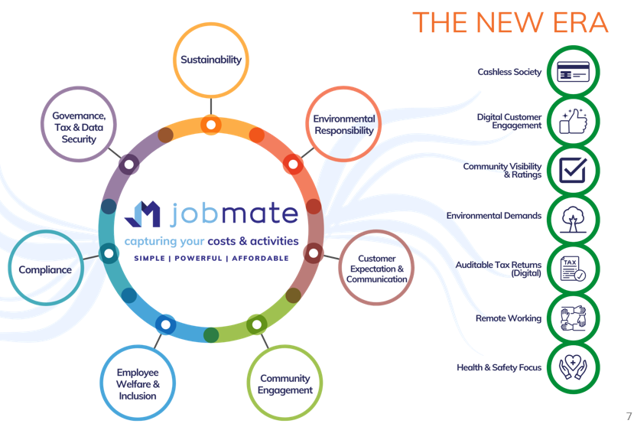
ESG Adoption by SMBs
Delivers the tools all businesses require to ensure compliance with their responsibilities to humanity.
Environment, Social, Governance

